Slide 1
CHROMOSOMES and MEIOSIS
EQ: What is the importance of meiosis in providing genetic variation?

Slide 2
SPECIALIZED CELLS
You have many specialized cells in your body that can be divided into two groups
1. SOMATIC = body cells; make up most of your
tissues and organs
(DNA in these cells is NOT passed on to your offspring)
2. GERM = sex/reproductive cells
Develop into gametes → sex cells (egg and sperm)
(DNA in your gametes CAN be passed to your offspring)

Slide 3
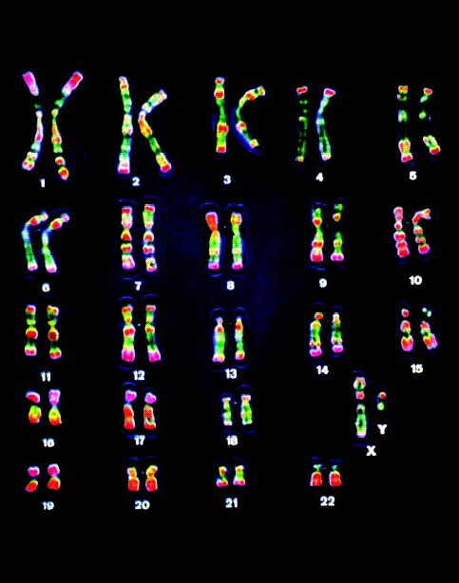
CHARACTERISTIC # OF CHROMOSOMES
Each species has characteristic number of chromosomes per cell
NOT related to complexity of the organism
Fern – 1200 chromosomes
Fruit fly – 8 chromosomes
**Humans – 46 chromosomes (23 pairs)**

Slide 4
CELLS HAVE AUTOSOMES AND SEX CHROMOSOMES
Humans: 46 chromosomes in every cell; 2 sets of 23 (one from mom and one from dad)
- need both sets to function properly
Each pair of chromosomes is a homologous pair
- “having the same structure”
- same length and general structure
- have copies of same genes

Slide 5
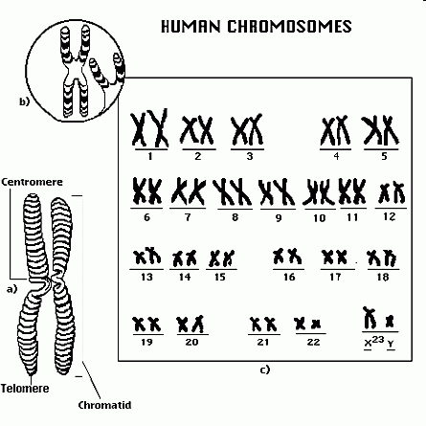
**AUTOSOMES**
Chromosome pairs 1 through 22
Contain genes for characteristics not directly related to the sex of an organism

Slide 6
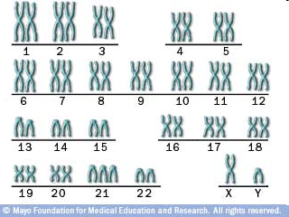
**SEX CHROMOSOMES**
Chromosome pair 23*
Directly control the development of sexual characteristics
abnormality

Slide 7
MAMMALS - XY SYSTEM
Humans: X and Y possible sex chromosomes
XX = female
XY = male
X and Y are NOT homologous
X is larger and contains numerous genes, many unrelated to sexual characteristics
Y contains genes that direct development of the male reproductive organs and other male traits; smallest chromosome and carries the fewest genes

Slide 8
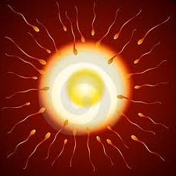
*SEXUAL REPRODUCTION*
Involves fusion of 2 gametes that results in offspring that are a genetic mixture of both parents
Fertilization: the actual fusion of an egg and sperm cell
- each have half the usual number of chromosomes
You were a WINNER from the beginning!!!

Slide 9
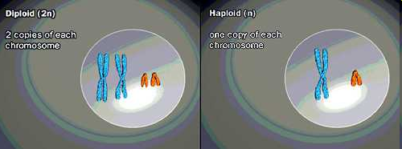
DIPLOID AND HAPLOID CELLS
Diploid (2n) – a cell has 2 copies of each chromosome
1 from mom, 1 from dad
Body cells
Humans diploid number is 46
total chromosomes
Haploid (n) – a cell has only 1 copy of each chromosome
Gametes (sperm and egg)
22 autosomes and 1 sex chromosome

Slide 10
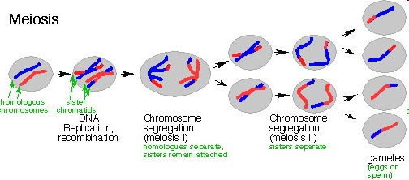
MEIOSIS (look on pg 273 for a visual description)
Germ cells in your reproductive organs undergo meiosis to form gametes
Form of nuclear division that divides a diploid cell into haploid cells
Essential for sexual reproduction
Notes:
Click on the title "Meiosis" to see an animation

Slide 11
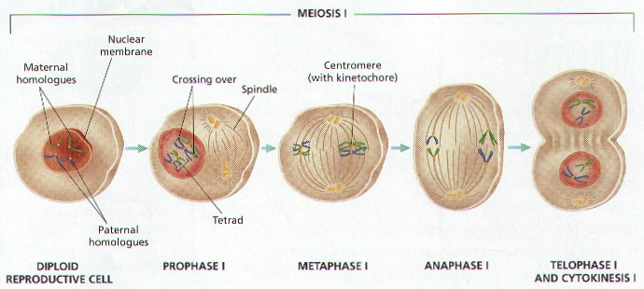
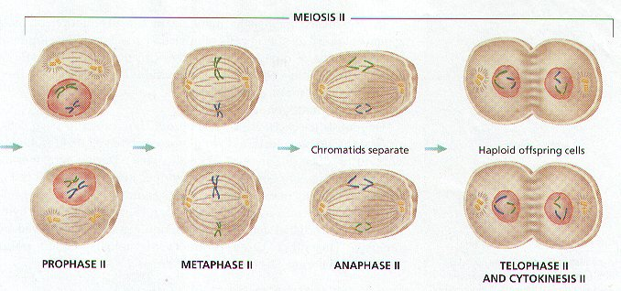

Slide 12
II. The Phases of Meiosis
In meiosis, cells divide twice after a single DNA duplication.
Meiosis I – Separates homologous (like) chromosomes.
1. Prophase I
a. Chromosomes coil tightly & are visible
b. Nuclear membrane & nucleolus disintegrate
c. Spindle forms
d. Synapsis (joining) of homologous chromosomes occurs making tetrads (groups of 4 chromosomes)
2. Metaphase I
a. Tetrads become aligned in the center of the cell attached to spindle fibers
b. Chromosomes in tetrad exchange fragments by a process called Crossing-Over (reason daughter cells are NOT identical)
3. Anaphase I – Homologous chromosomes separate
4. Telophase I
a. May not occur in some species
b. Cytokinesis occurs producing 2 cells
c. In females, the 2nd cell or first polar body dies due to uneven splitting of
the cytoplasm

Slide 13
Meiosis II – Separates homologues (sister chromatids)
1. Prophase II
a. Cells are called secondary spermatocytes or oocytes
b. DNA is not copied before cell divides
c. Chromatids attach to spindle fibers
2. Metaphase II
chromosomes become aligned in the center of the cell attached to spindle fibers
3. Anaphase II
a. Sister chromatids (homologues) separate randomly
b. Called independent assortment
4. Telophase II
a. Cytokinesis occurs producing 4 cells in males called spermatids
b. Spermatids mature and form flagellum to become sperm
c. Cytokinesis in females produces a 2nd Polar Body (that dies) and an ootid
d. Ootids mature to become ovum or egg

