Slide 1
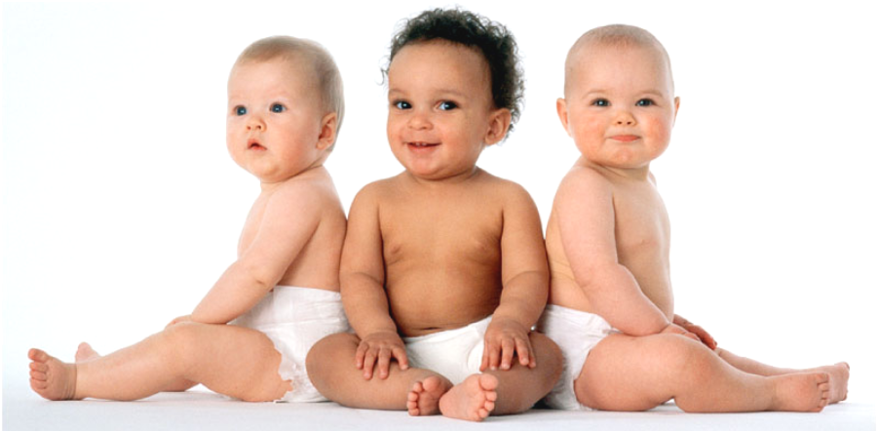
Human Genetics
EQ: How can genetic patterns be analyzed to determine dominant or recessive inheritance patterns?

Slide 2
Human Chromosomes
Karyotype = picture of chromosomes arranged in pairs & organized by size
Humans have 46 chromosomes(23 pairs)
2 of these (1 pair) are sex chromosomes
XX = female XY = male
The other 44 (22 pairs) chromosomes are known as autosomes

Slide 3
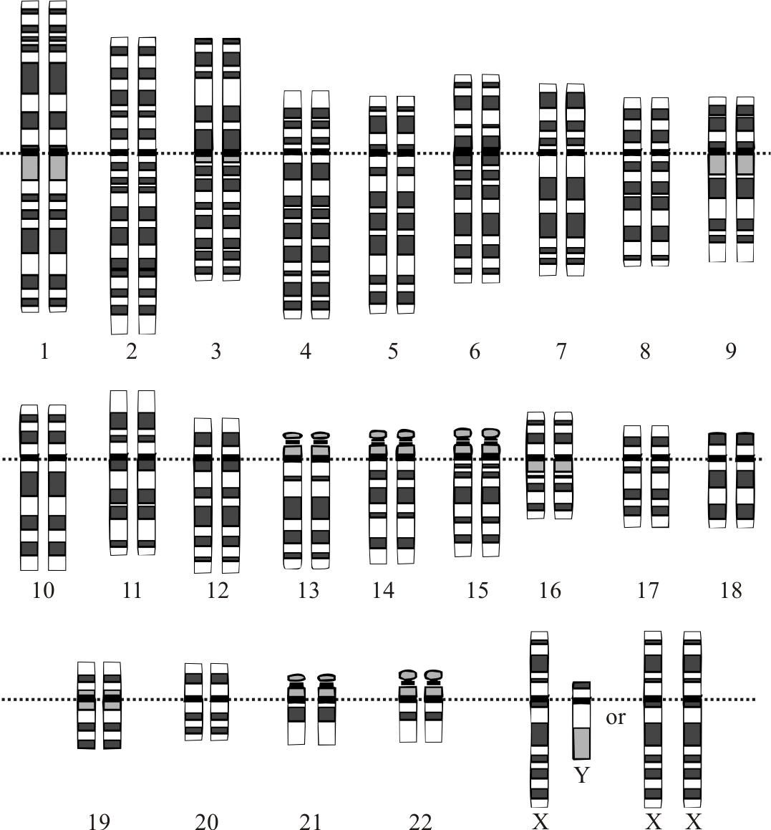

Slide 4
NONDISJUNCTION
Failure of chromosomes to separate in meiosis – results in an egg (sperm) with too many or too few chromosomes. (trisomy or monosomy)
Resulting disorders:
Down Syndrome (extra #21)
Klinefelter Syndrome (XXY)
Turner Syndrome (XO)-only an X chromosome
Supermale (XYY)

Slide 5
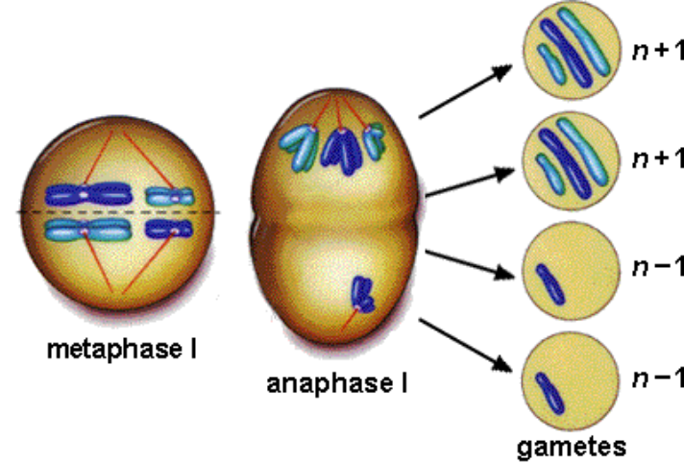
Trisomy – 3 chromosomes Monosomy – 1 chromosome

Slide 6
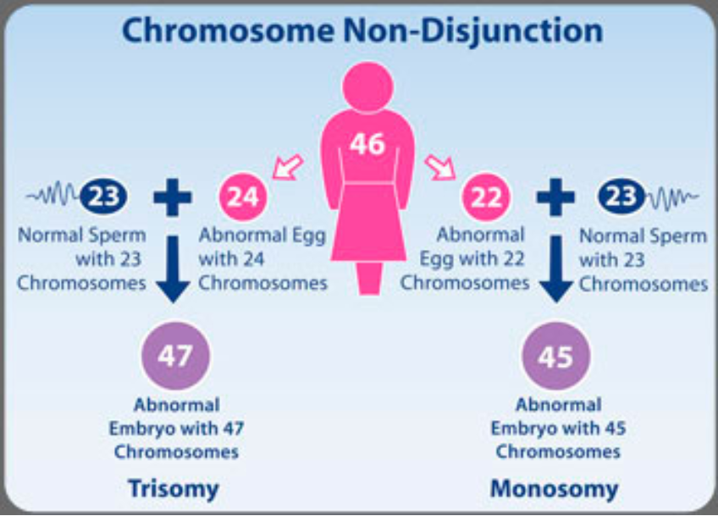

Slide 7
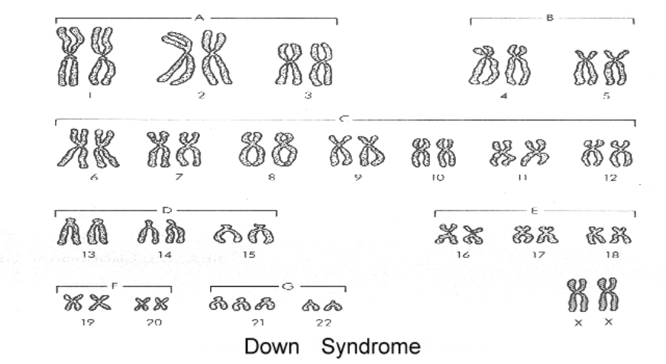
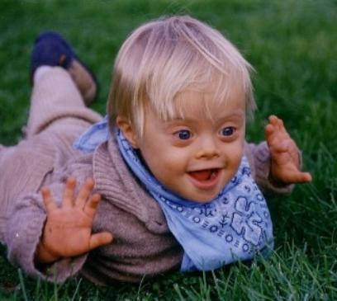
Down Syndrome
Trisomy 21

Slide 8
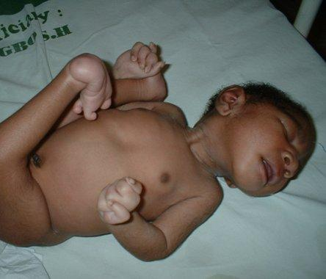
Edward Syndrome
- caused by an extra chromosome 18 (trisomy 18)
Median life expectancy is 4 days. However, about 5-10% survive beyond one year

Slide 9
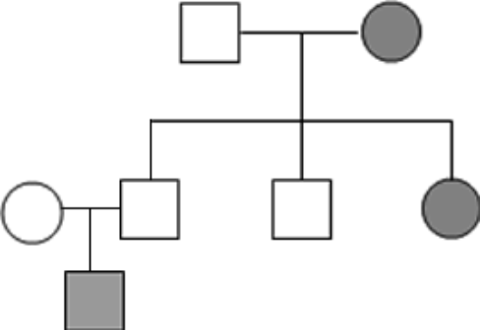
Human Traits
To study inheritance, biologists use pedigree charts
Shows relationships within a family

Slide 10
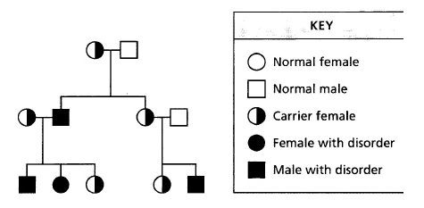

Slide 11
Recessive Genetic disorders
Phenylketonuria (PKU)
Tay – Sachs disease
Cystic Fibrosis
Galactosemia
Albinism * all recessive

Slide 12
Sex linked traits:
Some genes are located on the SEX CHROMOSOMES ( X and Y). X is larger than Y, so more genes are carried on this chromosome
Genes on the X chromosome may affect boys different from girls because girls have 2 X-chromosomes.
These are called SEX-LINKED GENES
examples:
Duchenne Muscular Dystrophy (recessive x-linked)
Colorblindness (recessive x-linked)

Slide 13
HEMOPHILIA - "bleeder's disease"
(recessive x-linked )
Blood will not clot normally, small injuries can be life threatening
Females can be carriers:

Slide 14
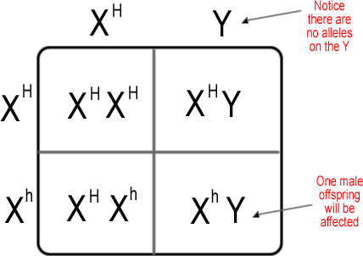
What happens if Mom is a carrier?

Slide 15
