Slide 1
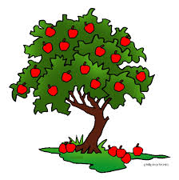
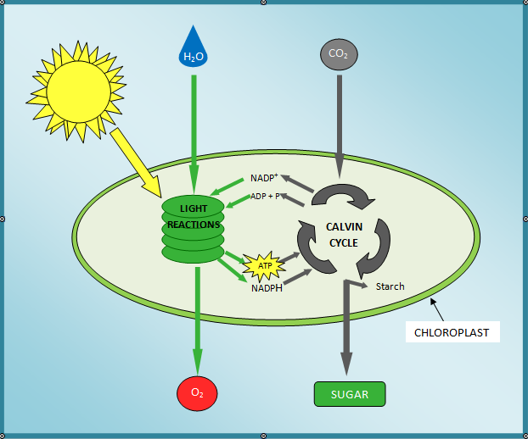
Photosynthesis

Slide 2
Trapping the Sun’s Energy
Photosynthesis the process by which plants capture energy from the sun to build carbohydrates(sugars) through chemical pathways
Glucose is the simple sugar that photosynthesis produces which the plant uses to store energy.
The equation that represents photosynthesis is:
6CO₂ + 6H₂O → C₆H₁₂O₆ + 6O₂
Solar energy

Slide 3
Phases of Photosynthesis
Photosynthesis requires energy from the sun, but the sun is not available 24 hours a day.
Photosynthesis must occur in two phases
Light-dependent Reactions (light reactions)
Convert light energy into chemical energy (ATP and NADPH)
Light-independent Reactions (dark reactions)
Uses the ATP and NADPH from the light-dependent reactions to build glucose
6CO₂ + 6H₂O → C₆H₁₂O₆ + 6O₂
Solar energy

Slide 4
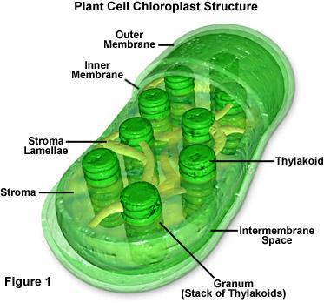
The Role of Chloroplasts and Pigments
Photosynthesis takes place in the chloroplasts
Light-dependent reactions take place in the membranes of the thylakoid disks (contain chlorophyll)
Light-independent reactions take place in the stroma (thick fluid that forms the framework of a chloroplast)

Slide 5
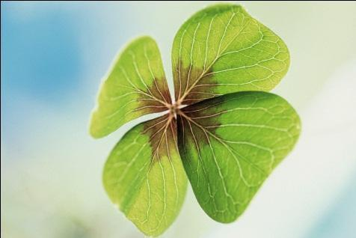
The Role of Chloroplasts and Pigments
The thylakoid membranes contain the pigments that can absorb certain wavelengths of sunlight.
The most common pigment in the chloroplasts is chlorophyll.
Chlorophyll a and b absorb most wavelengths of light except for green. Green is reflected making the plants appear green.
In the fall, plants reabsorb chlorophyll leaving other pigments that reflect other wavelengths of light – making the leaves appear red, yellow, or orange.

Slide 6
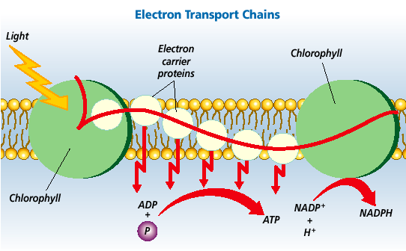
Light-dependent Reactions
Sunlight strikes the chlorophyll molecules in the thylakoid membrane.
Light energy is transferred to electrons
The electrons become highly energized and are passed down an Electron Transport Chain

Slide 7
Light-dependent Reactions
The Electron Transport Chain is a series of proteins in the thylakoid membrane
As the electrons are transferred from one protein to another, some energy is released which
helps join ADP and a phosphate to form ATP
extra energy helps pump hydrogen ions into the center of the thylakoid disk where they join with NADP+, forming NADPH (electron carrier)
ATP and NADPH will be used during the light-independent reactions

Slide 8
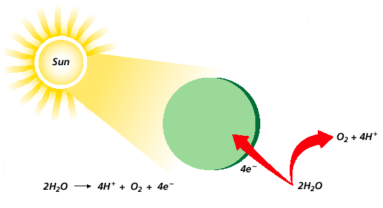
Light-dependent Reactions
The electrons excited by the light energy that passed down the electron transport chain and left with NADPH need to be replaced so the reaction can happen again.
To replace those electrons, a water molecule is split (photolysis), sending electrons back to the chlorophyll and releasing Oxygen and Hydrogen ions into the atmosphere – this supplies the oxygen that we breathe
Photolysis →

Slide 9
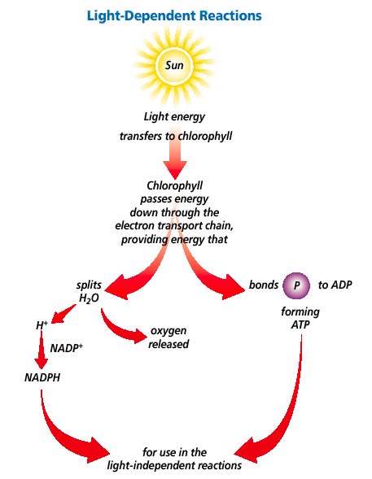
Light-dependent Reactions
Solar Energy absorbed by chloroplasts
Oxygen released
ATP Released
Products of Light Reactions (ATP and NADPH) fuel the dark reactions
NADPH released

Slide 10
Light-independent Reactions
The second phase of photosynthesis does not require light and is called the Calvin Cycle.
The Calvin Cycle occurs in the stroma of the chloroplast.
The Calvin Cycle uses the ATP and NADPH that was built during the light-dependent reactions

Slide 11
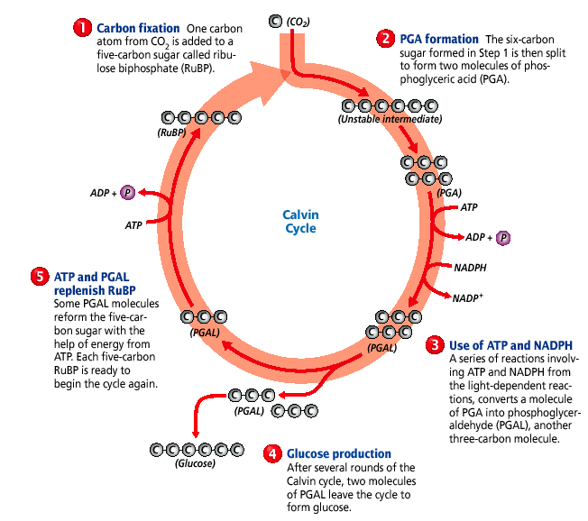
The Calvin Cycle
Uses Carbon Dioxide from the air
Uses ATP and NADPH from light reactions
Uses another ATP to replenish
Builds a glucose molecule

Slide 12
Photosynthesis Equation
Light Energy
6CO₂ + 6H₂O C₆H₁₂O₆ + 6O₂
chlorophyll
Carbon Dioxide from the air – Used in the Calvin Cycle during the Dark Reactions
Glucose Made in the Calvin Cycle during the Dark Reactions
Water Split during Photolysis in the Light Reactions
Oxygen Released during Photolysis in the Light Reactions
Plants can use this glucose molecule for energy during Cellular Respiration. Plants can also convert this glucose molecule into other organic compounds such as proteins and fats/lipids or other carbohydrates like starch and cellulose

Slide 13
Factors that Affect Photosynthesis
Carbon Dioxide (CO₂)
Without CO_{2,} the plant would not have one of the raw materials needed in the photosynthesis equation
CO₂ is used in the first step of the Calvin Cycle
Temperature
The temperature must be in the appropriate range for the plant in order for photosynthesis to properly occur

Slide 14
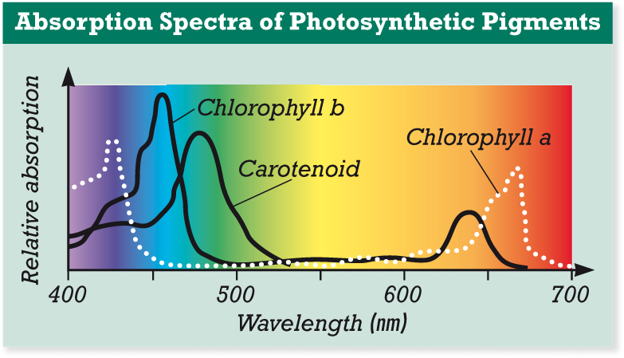
Factors that Affect Photosynthesis
Intensity & Wavelength(color) of Light
If the intensity of light is lower, the available energy for photosynthesis is lower.
In a greenhouse, if the light source is further away, intensity is lower and less photosynthesis can occur
If light is not available at all, the light-dependent reactions cannot occur (nor can they provide the materials used in the light-independent reactions)

